Slide 1
Digital Fraud detection Comparing ensemble and deep learning classification models
DATA606 – Data Science Capstone Project
Brian Morrison

Slide 2
Introduction & background
As many as 80% of consumers used some form of digital payment in 2020, with nearly 60% of those consumers reporting using two or more forms of digital payment¹
Credit and debit cards accounted for over 50% of payment usage in 2019²
Paralleling the growth of digital payment methods, instances of attempted digital payment fraud have also increased dramatically in the past few years, both in quantity and magnitude^{3,4}

Slide 3
Problem statement
Problem Statement: There are more ways to commit payment fraud today than there ever have been, and this statement will again be true in 10 years. Building and deploying a plethora of machine-learning based fraud detection systems, each with different approaches to classifying potential instances of fraud, is likely the best way to combat the wide range of ways individuals can commit fraud.
In this project, I propose methods for constructing robust fraud detection models, with a specific emphasis on comparing the performance of Ensemble and Deep Learning based classification models.

Slide 4
data
Large log of e-commerce transactions with a range of associated details
Made available through a Kaggle competition held by the IEEE Computational Intelligence Society (IEEE-CIS)
Contains over 590,000 real-world ecommerce transactions provided by Vesta
Split between transactional records with 392 unique numerical and categorical features, and identity records with 40 unique numerical and categorical features
Proportion of fraudulent to legitimate transactions standing at nearly 1 to 30; roughly 3.5% of the dataset.

Slide 5
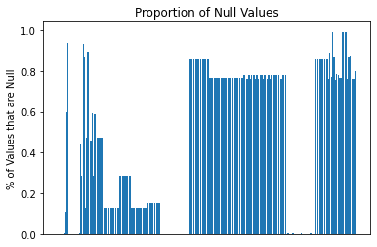
Null handling
Given the size of the dataset, all columns containing null values were removed
Likely a substantial amount of information loss, discussed in Future Directions section
After this, 17 features remained for the models to be trained on, along with the class labels column
Remaining categorical column was then One Hot Encoded

Slide 6
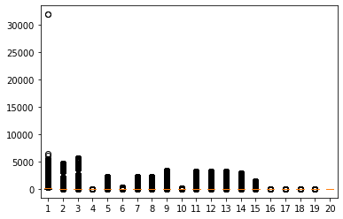
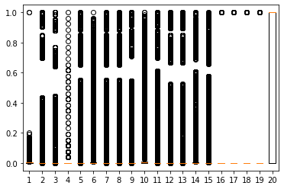
Feature scaling
Feature scaling, a prerequisite for some distance or gradient based models as well as Principal Component Analysis, was then performed
Two approaches to feature scaling that were explored:
MinMax Scaler - Designed for features confined to a definite range with roughly uniform distribution. Minimum to 0, Maximum to 1.
Robust Scaler - Designed to provide more tolerance for extreme outliers in leptokurtic data. Data is scaled according to the Interquartile Range (IQR).

Slide 7
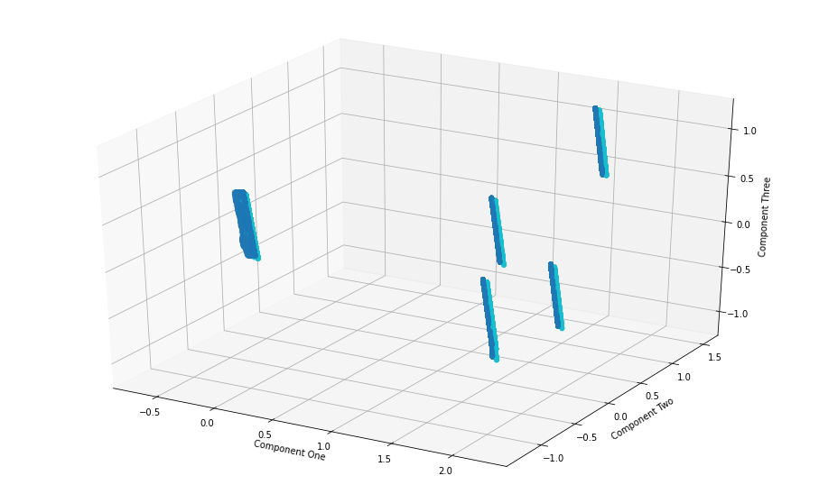
Class balancing 1
Many techniques to augmenting minority classes, including:
SMOTE - Creates synthetic data points similar to existing data points through a nearest neighbors approach by which neighbors close in feature space to existing minority class observations are imitated.
Random Oversampling - A simpler approach to minority class augmentation that involves randomly sampling minority class observations to duplicate in the dataset, artificially balancing class weights across the dataset.
PCA can be used to evaluate closeness in feature space

Slide 8
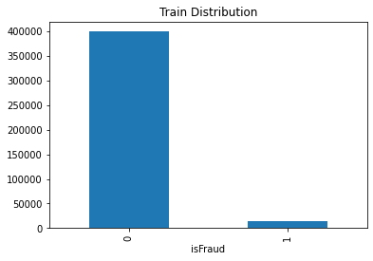
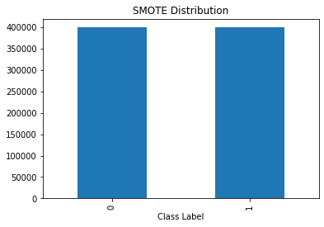
Class balancing 2
Both approaches to class balancing were used, with the expectation that later disparities in model performance could identify a winner
Boosting total quantity of transactions may have a number of outcomes
More data to refine models
Synthetic data may affect model’s ability to pick up real fraud

Slide 9
Ensemble (Stacking) model
Component models
information
AdaBoost Classifier
Linear Discriminant Analysis (LDA)
XGBoost
Logistic Regression
Ensemble, shallow tree-based
Linear, also popular for dim. reduction
Ensemble, tree-based
Final estimator
LazyPredict to select first 3 component models
Fits a number of small classification models to a partition of data
Returns models with highest accuracy, F1 scores
No hyperparameter tuning performed – discussed in Future Directions

Slide 10
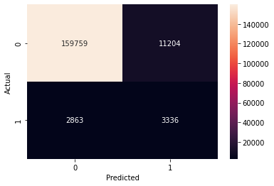
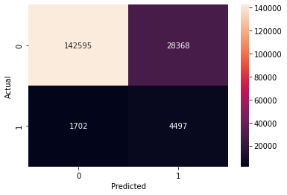
Stacking Classifier evaluation
SMOTE Performance
ROS Performance

Slide 11
Deep learning model
layer
information
Input
First Dense
Second Dense
Output
Expects array of 21 features
64 neurons, relu activation function
64 neurons, relu activation function
Sigmoid activation function
Relatively simple model, compiled with
Adam optimizer
Binary crossentropy loss function
Binary accuracy metric
Again, no hyperparameter tuning performed

Slide 12
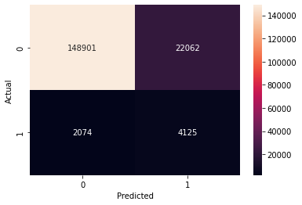

Deep learning model evaluation
SMOTE Performance
ROS Performance

Slide 13
Conclusions
In any machine learning use case, it’s important to reference our business context and stakeholder interests when evaluating the effectiveness of a model
Might want a precise model that minimizes resource allocation to false-flag investigations – like the SMOTE Stacking Classifier
Might want a “wider net” model that prompts users to dismiss alerts on any suspicious activity – like the ROS Deep Learning Model
The Kaggle competition’s leading submissions had combined F1 scores of nearly 0.95, portraying significant room to improve models

Slide 14
Future directions
Feature Engineering - More sophisticated methods to handle the presence of null values, such as replacing them with numeric constants (i.e. 0's) or merging them with populated fields from other columns, could assist in creating a more informative dataset
Hyperparameter Tuning - Using cross-fold validation to tune the hyperparameters of the models comprising the Stacking Classifier to ensure they are performing optimally. Identifying the ideal hyperparameters for simple classifiers by iteratively training and testing on partitions of the full dataset is a standard practice when building classification models
Transfer Learning - Exploring relevant pre-trained models that may elicit higher predictive validity in this use case could certainly be a way to improve the current project

Slide 15
references
https://www.mckinsey.com/industries/financial-services/our-insights/banking-matters/us-digital-payments-achieving-the-next-phase-of-consumer-engagement#:~:text=Although%20penetration%20of%20digital%20payments,to%20reach%20the%20remaining%20group.
https://www.frbsf.org/cash/publications/fed-notes/2019/june/2019-findings-from-the-diary-of-consumer-payment-choice/#:~:text=Consumers%20used%20cash%20in%2026,percentage%20point%20increase%20from%202017
https://resources.sift.com/ebook/digital-trust-safety-index-fraud-economy/
https://shiftprocessing.com/credit-card-fraud-statistics/

